Slide 1
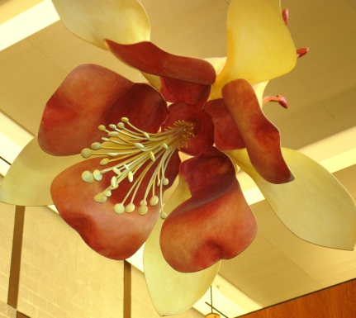

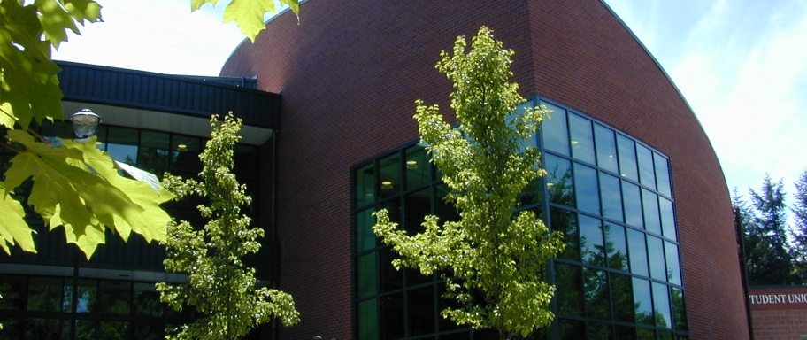
RUNNING START
ORIENTATION

Slide 2
Orientation
This orientation is for new Running Start students. It is required of all new RS students to attend an in person session prior to the start of the quarter.
The following slides are the actual presentation. Some slides have been modified to just let you know what information is given as we depart from the slide at that point in the actual presentation and go online to demonstrate the material.

Slide 3
What’s In My Packet?
First Quarter Checklist & campus map
Important Dates
High School Completion Options
Registration Information for Next Quarter
Degree Audit & Math Tree
Inclement Weather Procedures
Fee & Tuition waiver information
Release of Information

Slide 4
SPSCC Academic System
*
High School 1st Semester
Sept- Feb
Fall
September – December
12 weeks
College holidays and breaks are not always the same as your high school- if the college is in session you are expected to be in class even if your high school is closed.
You need to learn to plan out 6 to 12 weeks in advance for activities- college is not a “last minute” kind of system.
High School required activities do not automatically excuse you from your college classes.
*
Winter
January – March
12 weeks
High School 2nd Semester
Feb-June
*
Spring
April – June
12 weeks
Summer
July- August
8 weeks

Slide 5
TOBACCO FREE CAMPUS

Slide 6
PHOTO ID REQUIRED FOR TRANSACTIONS

Slide 7
Academic Standards
Must maintain a minimum of a 1.75 GPA for first 29 credits
Must maintain a minimum of a 2.0 GPA for 30 credits & above
1st quarter
Low GPA
2nd quarter
Academic probation
3rd quarter
Off academic probation
GPA OK
Cumulative GPA
College Level GPA
Pre-college and college level classes
College level classes only
1st quarter
Low GPA
2nd quarter
Academic probation
3rd quarter
Academic dismissal- no classes
Low GPA

Slide 8
Grades
Go back to your high school as they are at the college
Count for both college and high school GPA
Are not mailed home- available online or in building 25
Are a permanent record- you cannot get them “erased” or “excluded”

Slide 9
Student Email Accounts
We will use email to send you important information. We will use the email address you put on your Running Start application or you can sign up for a free SPSCC email account

Slide 10
Funding
Running Start covers tuition on courses within the funding limits table
Students are responsible for:
  Student Fees
  Course Fees
  Tuition on courses under the 100 level
  Tuition on courses over the funding limits
  All other costs (books, supplies, etc.)

Slide 11
Fee Waiver & Book loan
Fee waiver is available to any student who meets the income guidelines
  Documentation can be brought to campus or emailed to cwinstead@spscc.ctc.edu
Book Loan is available on a first come, first serve basis.
  Must qualify for fee waiver to qualify for book loan.

Slide 12
Reading your schedule
This section goes over how to read the class schedule print out and understand where classes are located and how fees/tuition are assessed.

Slide 13
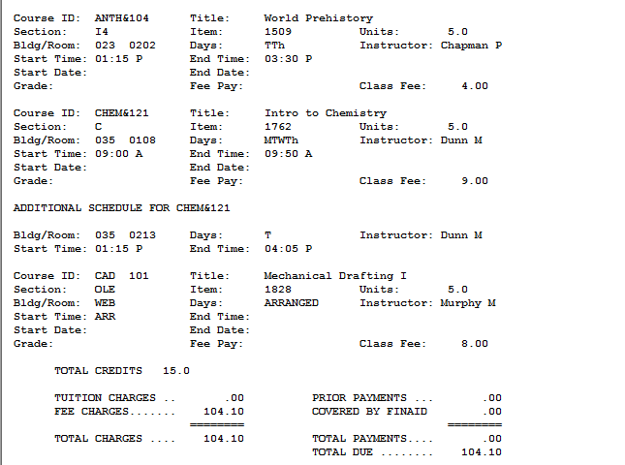
What Fees Am I Paying?
This student is paying:
$4.00
Enhancement fee
$40.00
Online course fee
(5 cr. x $8.00/cr)
$9.00
Lab course fee
$19.00
Student Building fee
(10 cr. x $1.90/cr)
$17.10
Student fee
(15 cr. x $1.14/cr)
$15.00
Matriculation fee
Online & hybrid courses have a $40 course fee.
This is paid to maintain the online site and access.
If a class accesses online enhancements (but is not a full online or hybrid class) there is a $4.00 enhancement fee
Lab classes (ex: CHEM, BIOL, ART) may have a lab fee of $5-$30.
This pays for consumables in the classroom.
Every student is charged a $15.00 matriculation fee.
This pays for parking lot and security services as well as provides funding to update student use things like increasing WiFi connectivity across campus
Every credit you enroll in has a Student Building fee ($1.90 per credit 1-10 credits) and Student Fee ($1.14 per credit 1-18 credits)
These fees were initiated and approved by the SPSCC student body.

Slide 14
Policies & Procedures
Missing Class
Meeting Prerequisites
Inclement Weather
Add/Drop Classes
Waitlist Classes
Required high school activities do not automatically dismiss you from college classes
Changes to your college classes you can make online or by filling out a registration form
Students and parents should have a “plan B” for bad weather to get the student to classes at the college
If you do not meet a prerequisite for a class you will be dropped from the class before the quarter begins
If the college is open and you miss class you could be penalized in your classes
If you have conflicting classes you will be dropped from the last class added after 24 business hours
If the college is open, you are expected to attend classes even if your high school is closed
High school is not signing off on whether or not you can take the courses- they are signing off on your funding limits.
When you are taken off the waitlist and put into a class, you will receive an email notification if your email address is up to date in our system.
Waitlisting means a class is at capacity, but you are putting yourself on a list so that if someone drops the class you can get in off the waitlist
If you are enrolled in the prerequisite class during the current quarter, you can register for the next class for the next quarter
Changes to your high school classes will require a new verification form if it affects your funding limits.
High school classes do not count as prerequisites for college classes except for Algebra II. With a “C” or better EACH semester you can get placed into college level math
The college will post to the major TV stations and radio stations any closures. You can also get email or text message notifications from www.e2campus.com/my/spscc
To receive a prerequisite override, you must contact the instructor and have them sign an add/drop form
Waitlists are for academic classes. Waitlists can take up to 30 students.
You are expected to contact your instructor if you will miss class
You have the right to fail your college classes- or to pass them!

Slide 15

Instructors…..
Expect you to get help if you are struggling in class:
Talk to the instructor
Use the writing and math center
Use the advising staff at SPSCC
Expect you to act as an adult (they do not know you are a Running Start student!)
Expect you to let them know if you will not be in class
Expect you to read the material given and take notes in class
Do not give classroom time for homework
Do not have “test make up”
Do not give “extra credit”
Expect you to be on time

Slide 16
Important Essentials
Parking
Student ID Card
Verification Form
PINS
Books
Registration PIN
Changes to your date of birth for 2nd quarter registration
Get your registration day and time online four weeks before registration begins
Global PIN
Always your date of birth MMDDYY
Use to access grades and transcripts
Will not allow you to add/drop classes online your first quarter
Buy books:
In store @ SPSCC
Online @ SPSCC
Online @ other retailers
Security Office has lots of information on off campus parking (FREE) and bus routes into campus (ALSO FREE!!)
Buy your books BEFORE the first day of class, but keep your receipts
Forms are always due one week prior to tuition due date
If you don’t turn in your form you will be charged full tuition for your courses
Search the booklist online at www.spscc.edu
Need to bring photo ID and a copy of your class schedule to get your SID card
Must turn in a new Verification form EACH QUARTER
Books average $65 to $100 per class
Look out for time conflicts between your high school and SPSCC. Arriving late for class is not acceptable.
To get your quarterly sticker you need to have your fees and/or tuition paid for the quarter
Quarterly stickers are available one week before the quarter begins
Quarterly sticker gets you discounts at TESC, movies and more
Give yourself at least 15 minutes to find parking between 8am and 12pm
Parking passes are no longer required on campus

Slide 17
Current Student Webpage
This section goes over the Current Student webpage and points out where to locate important information like:
Where to find your registration date and time for next quarter
How to get to the Advising homepage
Where the tutoring resources are located
Where to print a copy of your schedule
Where to check your grades
Where to pay fees/tuition online

Slide 18

Graduation Requirements
Each high school has different equivalency lists
Who owns the diploma? That’s who decides what counts
Work closely with your high school counselor even if you are full time at the college
To finish a college degree you will need to take 15 credits per quarter at the college
Finishing high school graduation requirements is the priority

Slide 19
Quarterly Timeline
Current Student registration begins the day after Advising Day and runs for three full days.
If you are working on a college degree set up an appointment with a college advisor now to talk about your degree and classes- appointments book fast!
Turn in your new Running Start Verification form & get your fees and/or tuition paid! Failure to complete these steps will result in you being dropped from your classes
Do a dry run of your transportation
Driving- need to know what traffic will be like
Bus- need to make sure you understand the bus routes and drop off/pick up locations
Watch for the new quarterly class schedule to go online under Current Students
ADVISING DAY- last chance to meet with a college advisor. Advising is by walk in only. Open 8am to 4pm.
You can register at any time after your assigned date & time.
Each quarter your registration time will move up. Students are given priority based on the number of credits completed. So the more credit you earn the quicker your time will move up.
It is important to register ON TIME every quarter to get the classes you need. Just because you need a class for high school graduation does not guarantee enrollment!
Print off your schedule the day before classes start- sometimes classroom locations change!
Go online or come to building 25
Set up a meeting with your high school counselor to discuss what classes you are going to take for the upcoming quarter
Check your Registration day & time online under Current Students > When Can I Register?
Remember this is the time you can register for classes- NOT an appointment with a college advisor!
On Advising Day all day classes are cancelled so students have time to meet with their advisor. You are assigned to the Welcome Center- so you can see any of our advisors!
“Week Zero”
Week Two
Week Four
Week Seven
0
2
4
7
11
Week Eleven

Slide 20

Questions?
Call
  360.596.5432 Anne Molenda
  360.596.5446 Christina Winstead
Email
  amolenda@spscc.ctc.edu Anne Molenda
  cwinstead@spscc.ctc.edu Christina Winstead
  advising@spscc.ctc.edu Advising Email

